Slide 1
Introduction to Prompting And ChatGPT
Ajay T Shaju
4th Year
Artificial Intelligence & Data Science
St. Joseph's College of Engineering and Technology, Palai
Notes:
Work done after zeroth review

Slide 2

Lets try generating it on some
Gen AI Image Generation Tools:
DALLE•2 Bing - DALLE•3

Slide 3
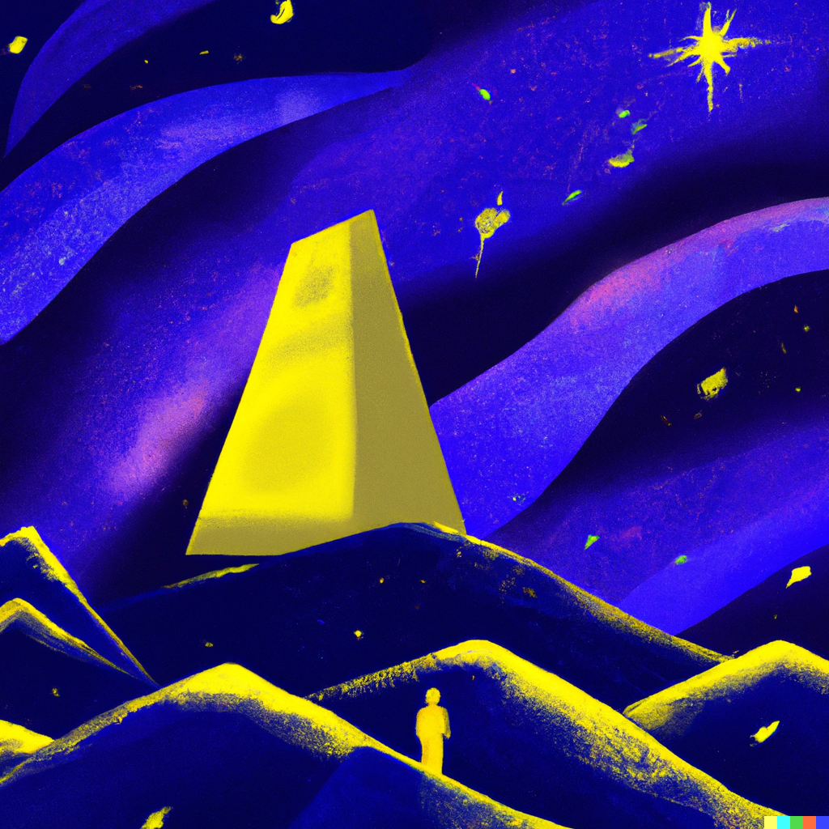
DALLE•2
Normal Prompt
Digital Art in the theme of a space, constellation and flying dust in dark blue and yellow color combination. A tall washington monument like building in the middle pointing to a yellow star, the monument is surrounded by small but bumpy mountains and celestial bodies. In one of the tall mountain there is a person standing with a victory feeling.

Slide 4
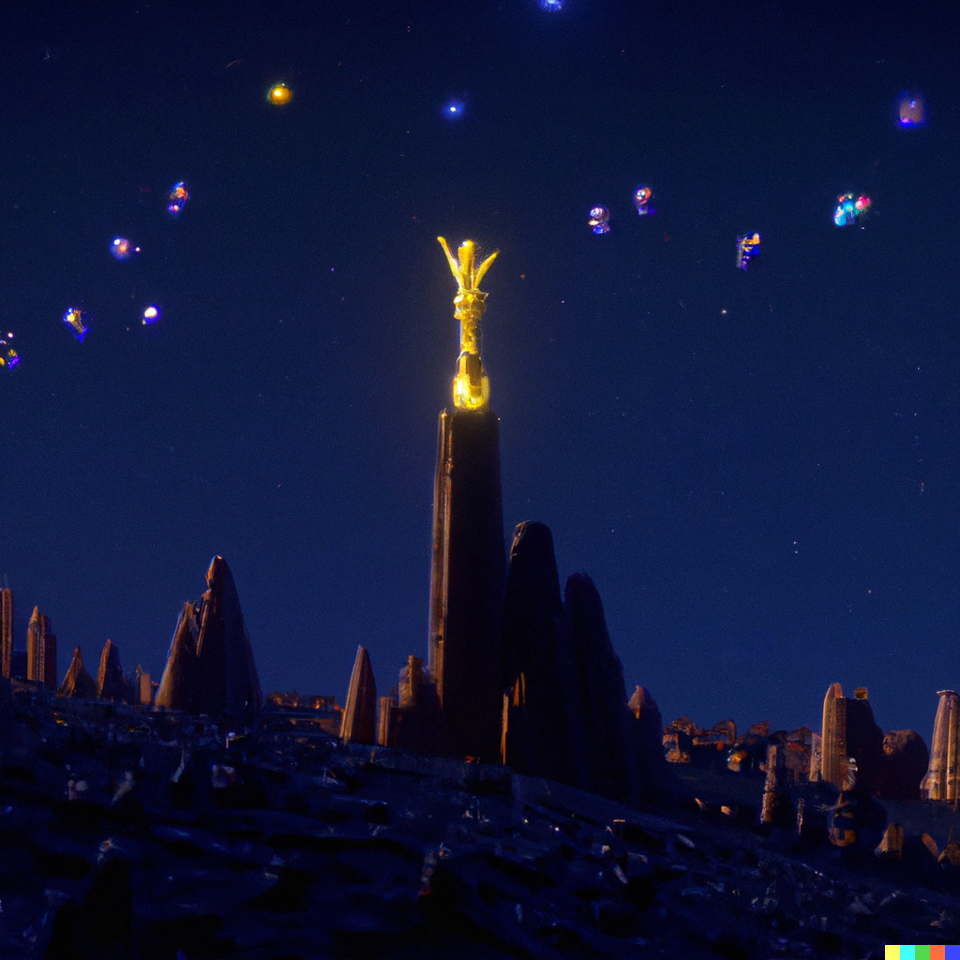
DALLE•2
Modified Prompt
Pixar, 8k, 4d, cinematic, theme of a space, constellation and flying dust in lite dark blue and yellow color combination. place a tall washington monument like building in the middle pointing to a yellow star, the monument is surrounded by small but bumpy mountains and celestial bodies. In one of the tall mountain there is a person standing with a victory feeling. Composition: Canon EOS 5DS R DSLR, EF 16-35mm f/2.8L III USM Lens, Resolution 50.6 megapixels, ISO Sensitivity: 200, Shutter Speed 1/60: ar 16:9

Slide 5

Bing - DALLE•3
Normal Prompt
Digital Art in the theme of a space, constellation and flying dust in dark blue and yellow color combination. A tall washington monument like building in the middle pointing to a yellow star, the monument is surrounded by small but bumpy mountains and celestial bodies. In one of the tall mountain there is a person standing with a victory feeling.

Slide 6
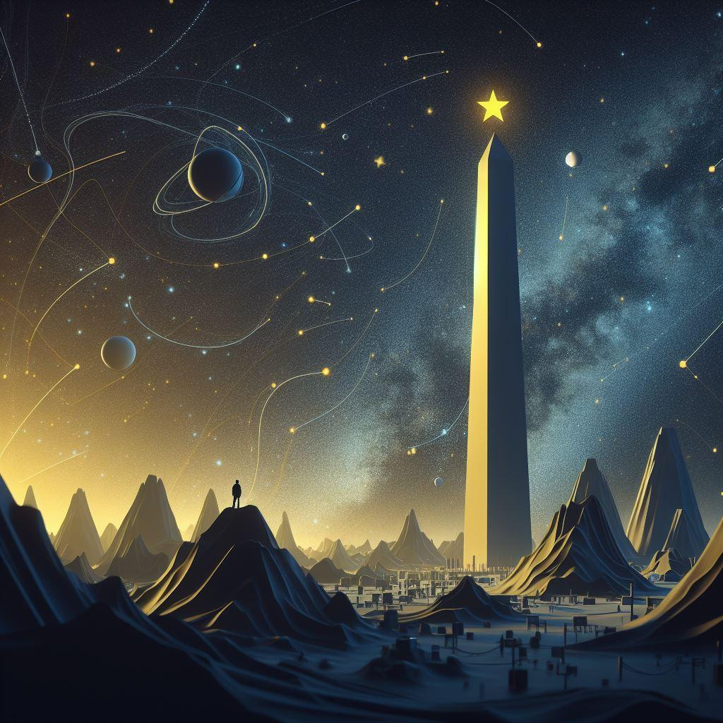
Bing - DALLE•3
Modified Prompt
Pixar, 8k, 4d, cinematic, theme of a space, constellation and flying dust in lite dark blue and yellow color combination. place a tall washington monument like building in the middle pointing to a yellow star, the monument is surrounded by small but bumpy mountains and celestial bodies. In one of the tall mountain there is a person standing with a victory feeling. Composition: Canon EOS 5DS R DSLR, EF 16-35mm f/2.8L III USM Lens, Resolution 50.6 megapixels, ISO Sensitivity: 200, Shutter Speed 1/60: ar 16:9

